Slide 1
Data Analysis Assignment
By Soumyajit Das

Slide 2
Problem Statement
Given the dataset for a CRM company having the data of products , sales made and data of companies who placed orders, Analyze and find insights for improving business and finding best performing agents.

Slide 3

SOLUTION
Break down the problem into subproblems.
Improve product sales
- Check which products sold more and earned more revenue with a scope of future sales and which company bought the most orders overall.
Find Best performing agents
-Analyse data like products sold per agent , revenue earned , companies attracted,etc
Check Regionwise performance
-Check regionwise contribution to revenue and products sold in them to analyze performance and

Slide 4


To boost sales , first find the products which have highest number of sales and find reasons behind it.
On analysis, it was found GTX Basic and MG Special sold the most in quantity
Possible reasons could be low prices ($550 and $50 respectively)
with good performance in the retail sector.
In revenue, GTXPro and GTX Plus Pro earned the most revenue
at $4821 and $5482 respectively ,
Possible reasons could be the extremely good performance at such
Prices, whilst not being overpriced like $26,000 like G
Finding the top 2 products that sold the most and earned the most revenue

Slide 5
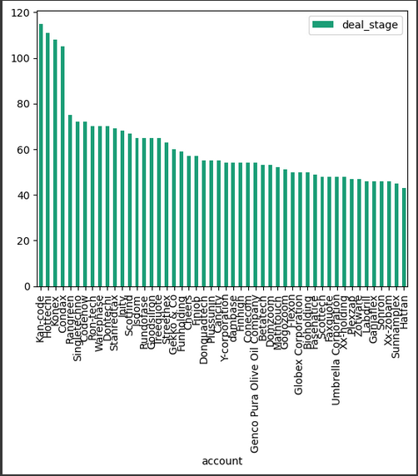

On analysis, it was found Kan-code placed the most orders
(115 orders)
To find the companies that placed the most orders

Slide 6
Product with most scope of selling in future
Checking the metrics on quantity and revenue and doing a sector-wise analysis
Retail sector dominated in almost every product, hence no scope of a product selling in particular sector.
GTK 500 had most sales and scope in entertainment sector.
Quantity suggests GTX Basic and Mg Special with high scope, however their sales are not much with $499,000 and $43,000 respectively,
Meanwhile , GTX Pro sold the third most with 729 units and grossing $ 3.5 million
Overall , considering both factors, GTX Pro has highest scope of sale with GTX Plus Pro being second highest.

Slide 7
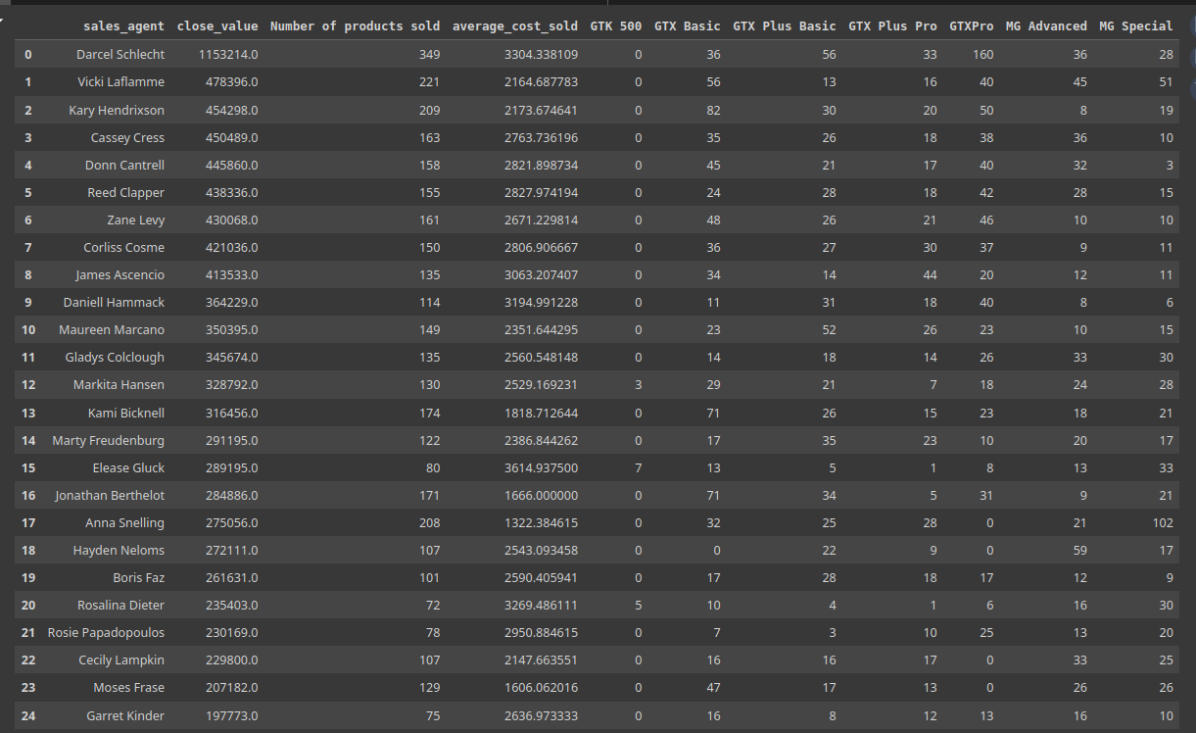
To find best performing sales agents ,
Three criteria were used to judge the agents for best performance:
Revenue earned
Number of unique companies attracted
Number of products sold.

Slide 8
Results
1. The most sales were 349 products sold .
2. Most revenue made by a single sales agent was 1.15 million USD.
(contributing to nearly 11 % of total company sales)
3. 55 unique companies was the highest number of companies attracted.

Slide 9
Best performing sales agent
On all three metrics, Darcel Schlecht had the best performance

Slide 10
To recommend the best performing agent on basis of bias
To check conditions like tenure in the company and certain conditions like country of employment to recommend the best performance agent .
Taking the maximum time served in company and country of India into account for this bias , Corliss Cosme is the best performing sales agent

Slide 11
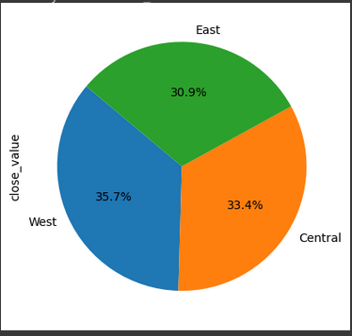
Analysis of region-wise performance
Analysis of regions and managers can help the company to make changes accordingly in regions
West performed the best in revenue earned, with east being the worst.
Central region’s performance was majorly contributed by Darcel Schlecht,
Under manager melvin marxen
Melvin marxen performed the best manager wise with Rocco neubert being
Second best, Dustin Brinkman and Cara Losch bring down the total in the
respective region.

Slide 12
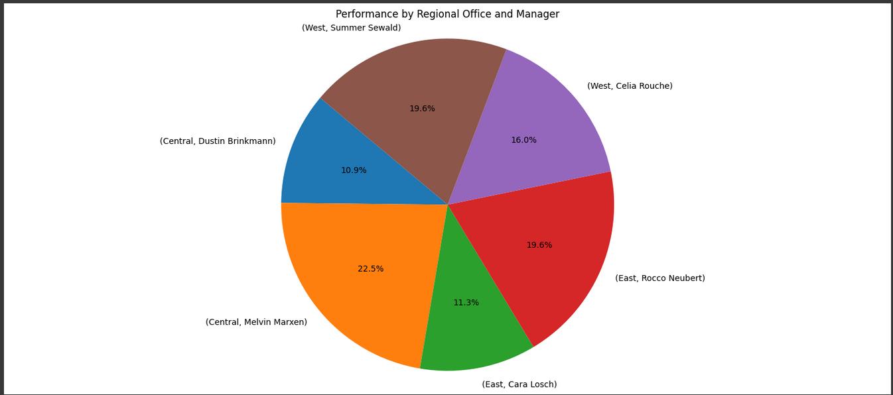
Visualizations of results
As noticed here , relatively poor performances of Dustin
and Cara brought down the percentages in each region.
In west , Celia and Summer have relatively better
performance.

Slide 13
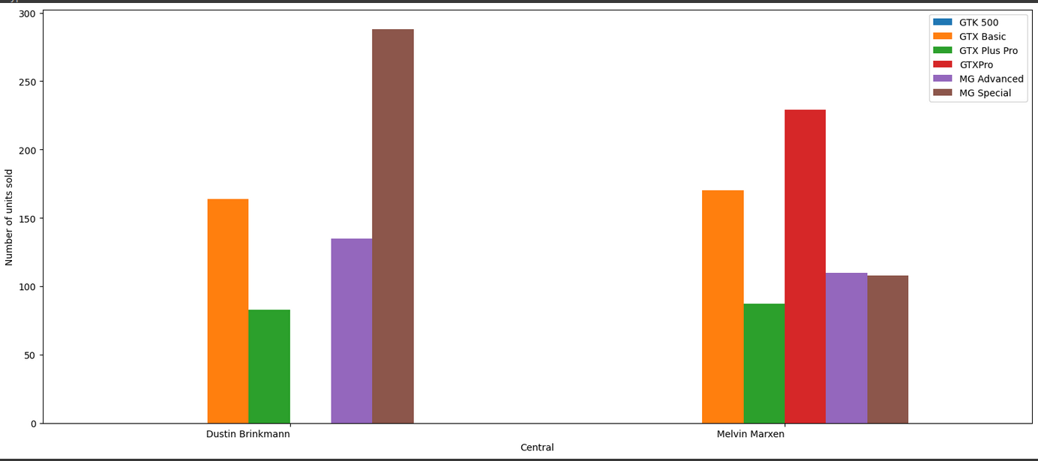
Region-wise product sales
Central office:
It is to be noted that Dustin couldnt sell any
GTXPro and a lot of the cheaper MG Special,

Slide 14
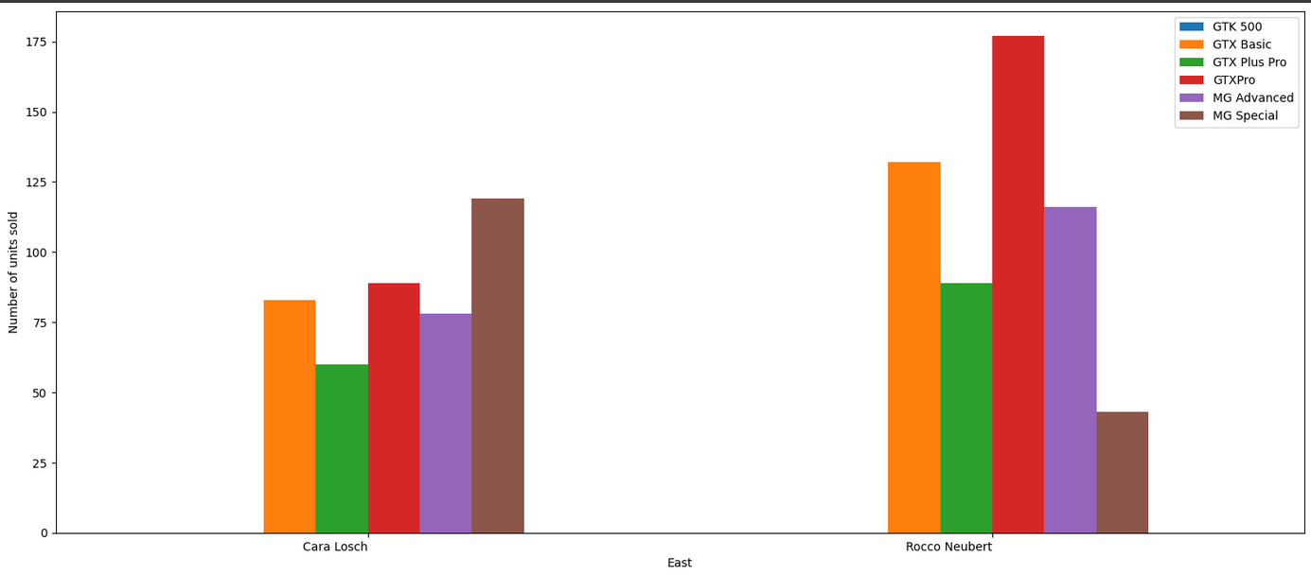
Region-wise Product sales
East:
Cara Losch also sold the most of MG Special,
And sold less of every product than rocco

Slide 15
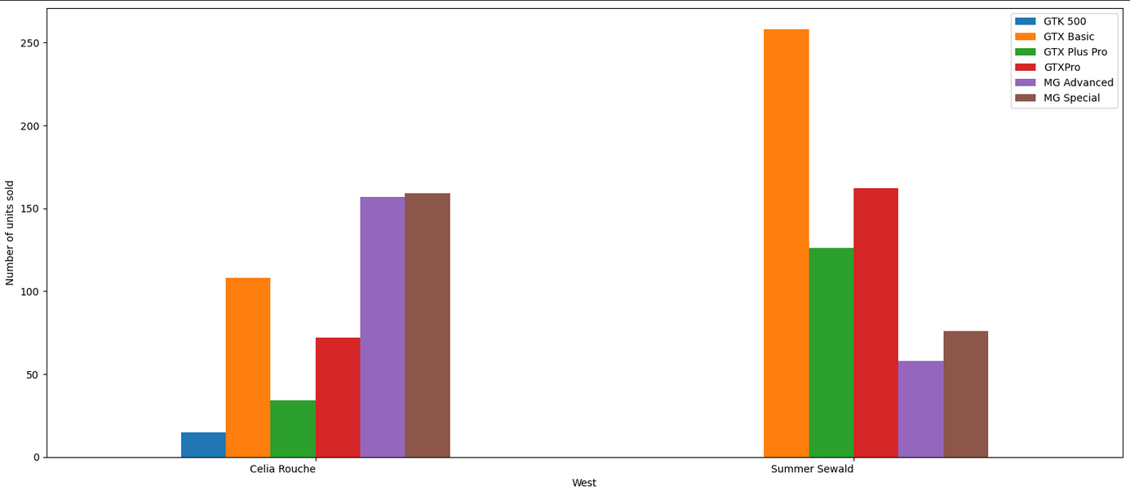
Region-wise performance
West :
Celia rouche was the only manager to show
any sales of GTK 500, getting $400k only by
these sales.

Slide 16
Tech Stack used
Python Pandas : - For data analysis and querying the table
Matplotlib :- For visualisation of the data and having the bar and pie charts.
Google Colab :- To execute the program without using local machine.

Slide 17
THANK YOU

